Slide 1
Managing the Evolution and Preservation of the Data Web

Slide 2
Does the Data Web need special treatment?
Linked/Open Data are Structured unlike documents
Linked/Open Data are Dynamic unlike closed settings in which change monitoring is build in a central authority
Linked/Open Data are Distributed and we need preservation techniques based on data replication enhanced with diachronic (temporal and provenance) annotations
Linked/Open Data are Uncertain because publishing and linking can be approximate and uncertain at best

Slide 3
3 Use Cases – 3 Different Evolving Models
Open Governmental data
“Data matchmaker” companies collecting data from Public sector, social networks, private sources, internal customer data and web data.
Multidimensional data in various formats (e.g., .csv, relational, dspl).
Open Enterprise data
Enterprise structured data →Employ LOD for building rich Data Intranets that will complement the traditional Document-oriented Intranets
Enterprise data models
Open Scientific data
Heavily curated Biological Data
Ontologies and data changes based on experimental validation

Slide 4
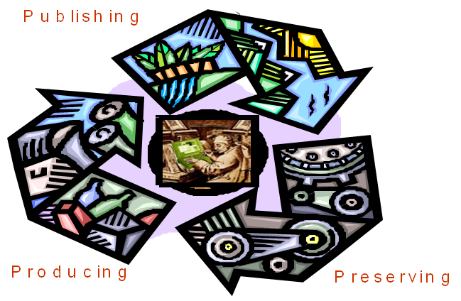
A Common Goal
Preserve data by keeping it constantly accessible & integrated into a larger framework of open and evolving data on the web.
Diachronic Data: Enhance data quality by annotating data with temporal and provenance annotations as data are re-used in complex value making chains
Effective & efficient techniques to manage the data lifecycle:
Linking
Integration
Publishing
Appraisal
Producing
Archiving

Slide 5
Main Objectives
How can we monitor/record changes of third-party LOD datasets?
How can we understand the evolution of LOD datasets w.r.t. the real world entities they describe?
How we can assess the quality of harvested LOD datasets?
in order to be able to decide which and how many versions of them deserve to be further preserved
How do we cite particular versions of a LOD dataset?
How will we be able to retrieve them in the form in which we saw it?
not the most recently available version

Slide 6
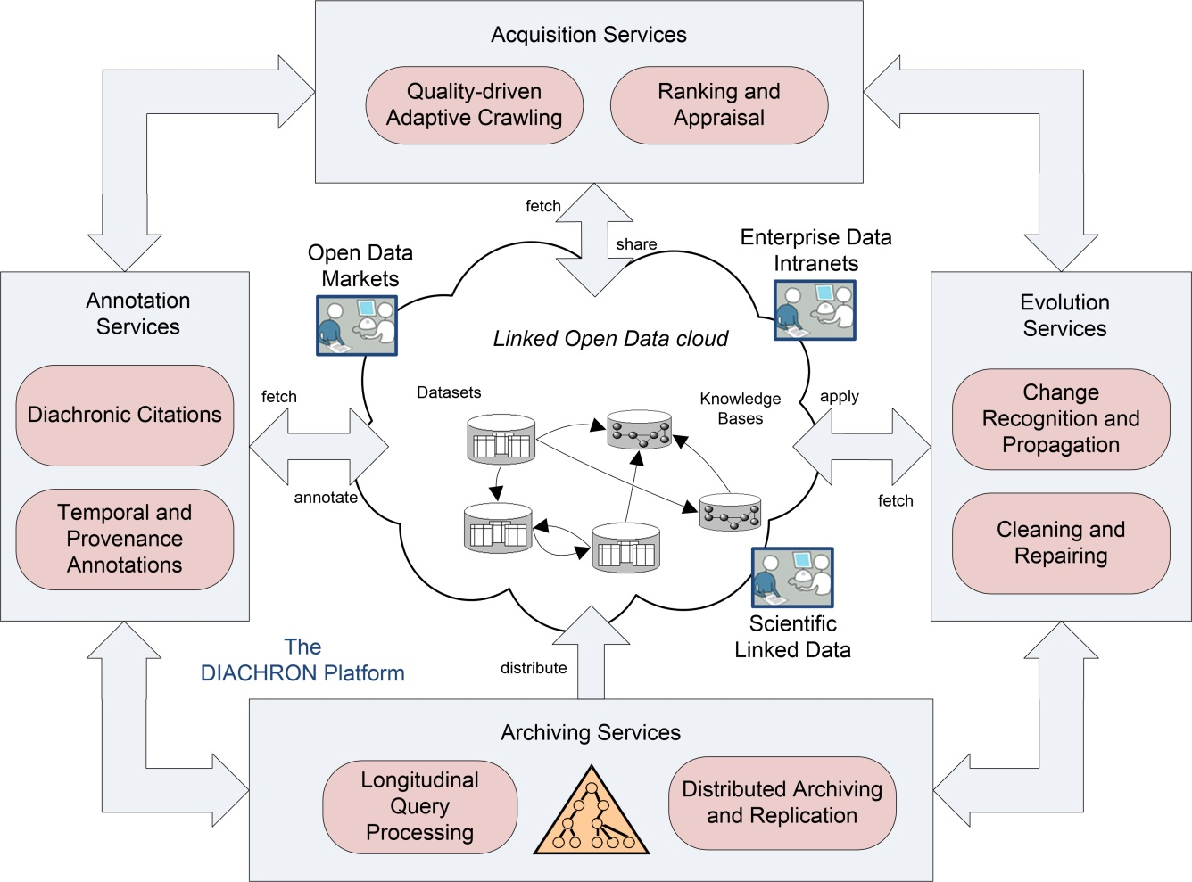
The DIACHRON Framework
Discovers new relevant data
from various domains
Collects superimposed information concerning provenance, interpretation, and use of data
Identifies and manages changes within the LOD cloud
Stores and accesses the data

Slide 7
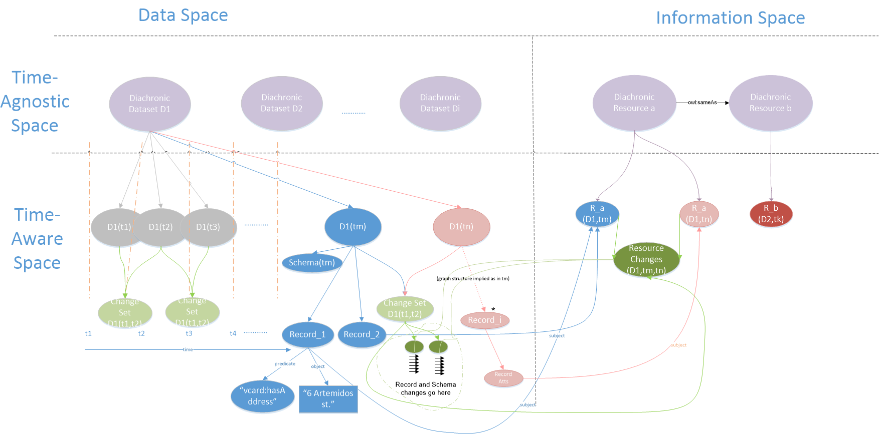
The DIACHRON Approach

Slide 8
Big Data?
Volume
Volume is manageable, however can become an issue
Variety
Support for different data models, mappings handled at deployment time
Velocity
Changes is a pivotal issue
Veracity
Provenance and Quality are central issues
Value
New types of services will add value to existing datasets

Slide 9
Project Info
DIACHRON
Managing the Evolution and Preservation of the Data Web
Start date: 01-04-2013
Duration: 36 months
Programme: FP7-ICT-2011-9
Project webpage:
http://www.diachron-fp7.eu/
Partners:
INTRASOFT, ATHENA, DATAPUBLICA, DataMarket, HANZO, Univ.Leipzig, EMBL, FORTH, Univ.Edinburgh, BROX

Slide 10
More exciting results soon…

