Slide 1
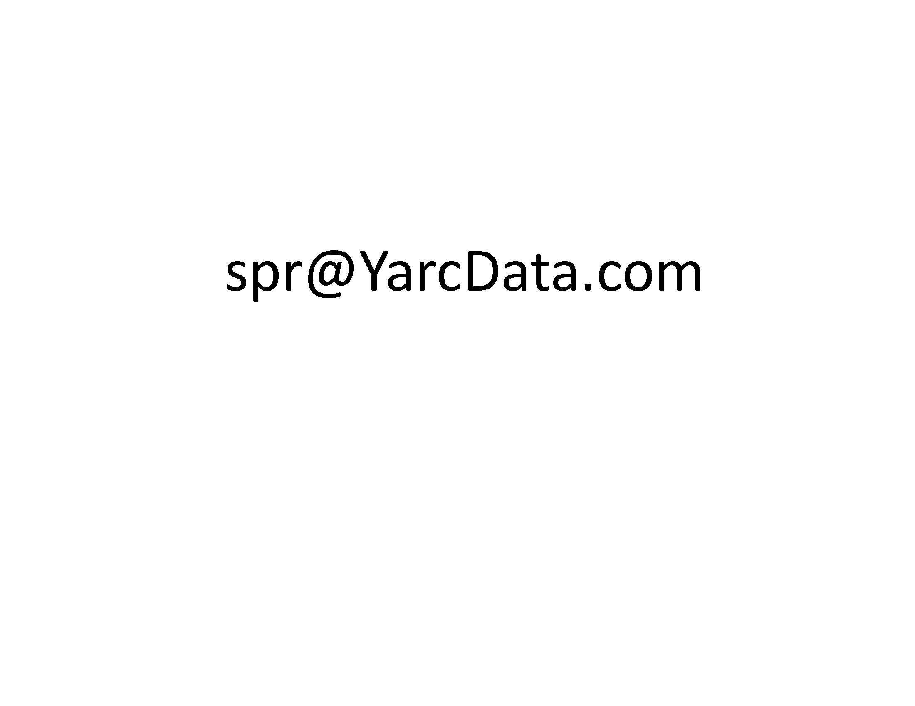
Implementing Iterative Algorithms with SPARQL
Robert Techentin, Barry Gilbert, Mayo Clinic
Adam Lugowski, Kevin Deweese, John Gilbert,
University of California Santa Barbara
Eric Dull, Mike Hinchey, Steven P. Reinhardt, YarcData/Cray
GraphQ 2014, Athens

Slide 2
Agenda
YarcData/Cray’s interest in graphs and SPARQL
Approach to using iterative algorithms with SPARQL
Three implementations
Lessons
Future work

Slide 3
YarcData/Cray and Graphs
YarcData develops and sells the Urika™ graph appliance
An in-memory graph store scalable to 512TB of RAM
Based on RDF/SPARQL standards
Shipping since Jan2012
Typically working with 10-40B triples
Target market is “discovery analytics”
Subject-matter expert (human) is in the loop
“Discovery” means a) need interactive response time (O(10s of seconds)) and b) queries are not known in advance

Slide 4
Iterative Algorithms
Rich recent work in machine learning and related fields
Want to reuse these algorithms on graphs, in RDF/SPARQL
Many important algorithms are iterative (e.g., PageRank, Markov clustering, SVD)
SPARQL has no mechanism for iteration
And using nested queries appears insufficient

Slide 5
Implementation Approach
Overhead of a SPARQL query is small enough to implement via multiple queries
Resulting structure
establish initial state
do {
update state
measure convergence criteria } while (convergence not met)
establish final state and clean up
Intermediate state is typically large, so want it to reside in the DB, hence need to INSERT it

Slide 6
Algorithms Implemented
Peer-pressure clustering (UCSB, YD)
Clusters vertices by propagating the most popular cluster of each vertex’s neighbors
Graph diffusion (Mayo, YD)
Models natural transport process, using the connectivity of the graph
Can quantify which connections were most important to transportation
Label propagation (YD)
Similar to peer-pressure
Clusters vertices by popularity, with self-voting possible

Slide 7
Peer-pressure Clustering
Algorithm
assign each vertex to an initial cluster of its own
do {
(re-)assign each vertex to the cluster to which a plurality of its neighbors belong
count the number of vertices that changed cluster in the prior step
} while (enough vertices changed or other criteria)

Slide 8
Vertex-(re)assignment Query
INSERT {
GRAPH <urn:ga/g/xjz[i+1]> { ?s <urn:ga/p/inCluster > ?clus3 }
} WHERE {
{ SELECT ?s (SAMPLE(?clus) AS ?clus3)
WHERE {
{ SELECT ?s (MAX(?clusCt) AS ?maxClusCt)
WHERE {
SELECT ?s ?clus (COUNT(?clus) AS ?clusCt)
WHERE {
?s <urn:ga/p/hasLink > ?o .
GRAPH <urn:ga/g/xjz[i]> {?o <urn:ga/p/inCluster > ?clus}
} GROUP ?s ?clus
} GROUP BY ?s
}
{ SELECT ?s ?clus (COUNT(?clus) AS ?clusCt)
WHERE {
?s <urn:ga/p/hasLink > ?o .
GRAPH <urn:ga/g/xjz[i]> {?o <urn:ga/p/inCluster > ?clus}
} GROUP BY ?s ?clus
}
FILTER (?clusCt = ?maxClusCt)
} GROUP BY ?s
}
}
For each vertex, find the cardinality of the most popular cluster to which its neighbors belong
For each vertex, find the name and cardinality of each cluster to which its neighbors belong
For each vertex, select the cluster which has cardinality equal to maximum cardinality

Slide 9
Lessons
Pros
This approach works
Implementation is within the control of the developer, as it depends solely on standard SPARQL 1.1 and SPARQL Update functionality
Performance can be very good
Cons
Implementation requires use of a second language for iteration (JavaScript and Python, in our cases); this complicates development, esp. debugging
Computational inefficiencies
Executing the same selection code (to focus on the vertices/edges in question) in each query is redundant
INSERTing intermediate results is a heavier-weight operation than required

Slide 10
Lessons (2)
Performance
In RDF graph, data to be clustered is typically a small fraction of the total data
Largest algorithm data 89M vertices / 1.6B edges
Iteration times 40-1200s, depending on data size
Number of iterations varies by algorithm and data
Need algorithms that cope with heterogeneous data

Slide 11
A Related Development
The ability to call a (possibly iterative) graph function built into the SPARQL endpoint
PREFIX yd: http://yarcdata.com
CONSTRUCT {
# input graph for community detection algorithm consists of weighted edges
?vertex1 ?weight ?vertex2 .
} WHERE {
?vertex1 <urn:hasLink> ?vertex2 .
# following statement weights intra-clique edges 10X more than inter-clique
BIND (IF(SUBSTR(STR(?vertex1),11,11)=SUBSTR(STR(?vertex2),11,11),
"10"^^xsd:integer, "1"^^xsd:integer) as ?weight)
}
INVOKE yd:graphAlgorithm.community (maxCommunitySize=200)
PRODUCING (?vertex ?communityID)
New feature in Urika Spring 2014 release
Likely better performance, though less control by query developer

Slide 12
Summary
Implementing iterative algorithms through sequences of SPARQL queries is a reasonable approach
Delivers good performance and great query-developer flexibility
Inherent performance issues may inhibit extreme performance
Likely to be one of a variety of means to implement graph algorithms in SPARQL

