Slide 1
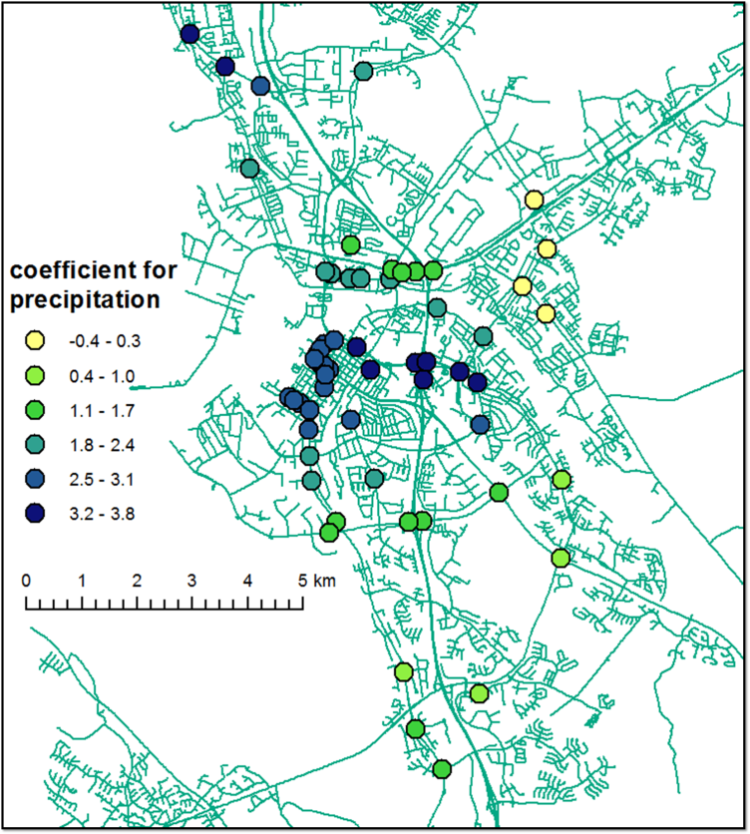
Analysis of Relationships between Road Traffic Volumes and Weather: Exploring Spatial Variation Jaakko Rantala and James Culley
Need
Previous studies for the modelling of traffic flow and volumes have assumed that the relationships hold constant for the study area
Spatial dependency has not been studied
Solution
1) Study coefficients from regression models at individual locations
2) Spatial dependency found => Create local model to incorporate spatial variation into the model
Benefits
Coefficients from the local models can be plotted to study the relationship between weather variables and traffic volume
Gain new insights into the data
How to utilize
More detailed predictions in urban planning and transportation

