Slide 1

Overcoming Semantic Drift in Information Extraction
Proc. 17th International Conference on Extending Database Technology (EDBT),
March 24-28, 2014, Athens, Greece
Zhixu Li, Hongsong Li, Haixun Wang,
Yi Yang, Xiangliang Zhang, Xiaofang Zhou
§King Abdullah University of Science and Technology, Saudi Arabia
†Microsoft Research Asia, Beijing, China
‡The University of Queensland, Brisbane, Australia
♭School of Computer Science and Technology, Soochow University, China.
2014.03.25

Slide 2
Outline
The Semantic Drift Problem in Information Extraction
Previous Methods for Overcoming Semantic Drift
Our Method
  Intuition
  What is DPs (Drifting Points)?
  How to find DPs?
  How to do DPs-based Cleaning?
Experimental Results
Conclusion
Notes:
Outline …

Slide 3
Two Bootstrapping IE Methods

Slide 4
Two Bootstrapping IE Methods
Semantic Drift happens in both cases!
Definition 1. (Drifting Errors). We call an instance as a Drifting Error w.r.t. a target class, if this instance does not belong to the target class but some other classes irrelevant to the target one.

Slide 5
Outline
The Semantic Drift Problem in Information Extraction
Previous Methods for Overcoming Semantic Drift
Our Method
  Intuition
  What is DPs (Drifting Points)?
  How to find DPs?
  How to do DPs-based Cleaning?
Experimental Results
Conclusion

Slide 6
Previous Work
1. Mutual exclusive: We consider two concepts as mutually exclusive, if they share no instances or sub-concepts.
  Eg. “Politicians” and “Cities” are exclusive, if we get “Beijing isA City” and “Beijing isA Politician”, there must be something wrong.
  Drawback: Can not identify error entities under non mutual exclusion classes.
2. Heuristic ranking-based Method: Only keep the most promising extractions in each iteration.
  E.g. According to the number and the reliability of patterns or sentences generating them
  Drawback: Hard to give a threshold, may cause a low recall.
3. Coupled Learning for IE: Coupling the simultaneous training of many extractors.
  They reported a high accuracy by enforcing constraints, including mutual exclusion, type checking, given as domain knowledge
  Drawback: hurt the recall of the extraction.
Notes:
Several ways have been used to prevent from semantic drift previously.
If an entity coexist in two mutual exclusive concepts, only one concept is correct for the entity. The other concept should be cleaned. Especially when one concept is overwhelming.

Slide 7
Outline
The Semantic Drift Problem in Information Extraction
Previous Methods for Overcoming Semantic Drift
Our Method
  Intuition
  What is DPs (Drifting Points)?
  How to find DPs?
  How to do DPs-based Cleaning?
Experimental Results
Conclusion

Slide 8
IE Process
CORE
(A, a1)
(A, a2)
      1st Iteration:
        A such as a1 and a2.
      2nd Iteration:
        A other than B such as a3, a4 and a2.
      3rd Iteration:
        C….. A such as a5 and a3.
        ………
Iter 2
(A, a1)
(A, a2)
(A, a3)
(A, a4)
Iter 3
(A, a1)
(A, a2)
(A, a3)
(A, a4)
(A, a5)

Slide 9
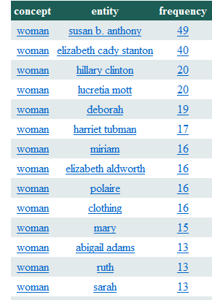
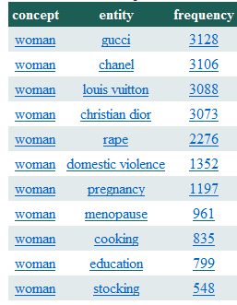
Observation from Example
The 1st iteration
After 5 iterations
        How this happens?

Slide 10
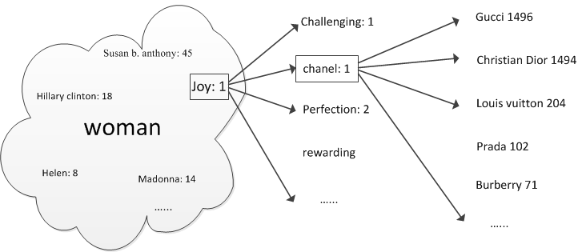
Intuition
Definition 2. (Dirfting Points (DPs)). We say an instance is a Drifting Point w.r.t. a target class if it introduces drifting errors to this target class.
Observation: 90+% erroneous extractions are introduced by DPs.
While erroneous extractions are the “symptoms” of semantic drift, DPs are the “causes” of semantic drift.
Notes:
An important observation is …

Slide 11
Types of DPs
1. An Intentional DP is a polysemous instance that belongs to both the target class and another irrelevant class.
  Hence, it tends to introduce instances from the irrelevant class into the target class as drifting errors, such as “Chicken” w.r.t “Animal”, “Chanel” w.r.t. “Women”
2. An Accidental DP is an extraction error by itself. It happens accidentally or randomly and is not aroused by other DPs.
  (1) Incorrectly parsed sentences, such as
    “... Animals … other than dogs such as cats ...”
  (2) Incorrect knowledge, such as
    “He has toured in various countries such as France, Portugal, New York, and Japan ...”,
Notes:
An important observation is …

Slide 12
Properties about DPs
Property 1. For a target class, the distribution of instances triggered by a DP is different from the distribution of instances that truly belong to the target class.
  -e.g., dog and cat both trigger extractions of animal instances only, but chicken also triggers some incorrect instances from other classes.
Property 2. If classes C1 and C2 are mutually exclusive, then an instance e ∈ C1 ∩ C2 is very likely an Intentional DP.
  -e.g., food and animal are mutually exclusive, so chicken is very likely an Intentional DP.
Property 3. An Accidental DP is usually supported by very weak evidence, that is, the instance is derived from very few (mostly only one) sentences.
  -e.g.,(New york, Country) is only extracted from one sentence.
Property 4. An error extraction (e isA C) triggered by a DP is usually supported by weak evidence, since the extraction is usually not triggered by other instances of C.
  -e.g., (LV, Women) is only triggered by (Chanel, Women).
The above four properties provide some clues to detecting DPs and drifting errors caused by DPs, but none of them is definite.
Notes:
An important observation is …

Slide 13
Comparison, Advantages
 | Directly Detecting Errors (Previous Methods) | DP-based Cleaning (Our Method)
Number of the Target | Large size | Much smaller
Types of the Target | Various kinds | Two Types only
Capture Difficulty | Not any identified common properties, so hard to be captured with a model | DPs have some common properties
✔
✔
✔
Notes:
An important observation is …

Slide 14
Outline
The Semantic Drift Problem in Information Extraction
Previous Methods for Overcoming Semantic Drift
Our Method
  Intuition
  What is DPs (Drifting Points)?
  How to find DPs?
  How to do DPs-based Cleaning?
Experimental Results
Conclusion

Slide 15
Detecting DPs
Learning-based: For each concept, a DP Detector will be learned to classify instances into three categories:
  (1) Intentional DPs,
  (2) Accidental DPs, or
  (3) non-DPs.
  Challenges: Requires large amount of training data. To make things worse, we have millions of concepts.
  We use semi-supervised learning to leverage unlabeled data for better understanding of the new data, and we use multi-task learning to improve our understanding of a certain concept by exploiting its related concepts.
  (1) Features
  (2) Preparing Training Set
  (3) Learning DP Detectors
Notes:
An important observation is …

Slide 16




（1）Features
For each concept C, each instance e is denoted as a feature vector：e := [f1(e), f2(e), f3(e), f4(e)].
  (1) Feature 1: the distribution of instances triggered by e
  (2) Feature 2: the number of mutually exclusive concepts that e belongs to
  (2) Feature 3: the quality of e
  (2) Feature 4: the quality of the sub-instances triggered by e
Notes:
An important observation is …

Slide 17
（2）Preparing Training Set
Evidenced correct instances (e.g., isA pairs) can be obtained from: (1) Verified sources (such as Wikipedia), or (2) Highly frequent extracted pairs in the first iteration.
But,
  (1) no direct samples for training DP detectors,
  (2) may not be enough for all concepts.
Our Solution:
With the evidenced correct instances, we define some heuristic rules based on the definitions of DPs and the mutually exclusive assumption to label a number of Intentional DPs, Accidental DPs and non-DPs.
Details are not given due to the limitation of time!
Notes:
An important observation is …

Slide 18
（3）Learning Method:
Challenges and Solutions
Challenge 1. Not enough training set: Labeled instances only cover 66.4% of the one million concepts.
  The left 33.6% have no training set, most of which are small concepts with no identified mutually exclusive concepts.
Our Solution: we leverage different kinds of knowledge instead of using more labels.
  Leverages unlabeled data for a better understanding of new data,
  but also exploits the knowledge in other related concepts.
Challenge 2. Over-fitting problem: The data labeled after the three rules probably has a biased distribution on feature 2.
  Due to these rules labeling DPs and non-DPs relying on the mutually exclusive relation between concepts.
Our Solution: we perform kernel Principal Component Analysis (PCA) to obtain a new representation of the original data, which won’t be biased to a single dimension.
Notes:
Among all the four features, only feature 2 concerns about mutually exclusive relation. As a result, a DP detector trained on this kind of labeled data set may over-fit to a single dimension.
Our premise is that it is cheaper to use a very large amount of unlabeled data than to manually annotate a larger portion of instances. Also, humans often adapt knowledge obtained from previous experiences to improve the learning of new tasks.
To address the problem of an insufficient number of labeled data, it is advantageous to adapt knowledge from other related concepts. In light of these, we propose a new algorithm, namely Concept Adaptive Drift Detection that not only leverages unlabeled data for a better understanding of new data, but also exploits the knowledge in other related concepts.
To avoid over-fitting to a single dominant dimension, we follow a commonly used method which performs a non-linear mapping to transform the original data into the kernels of the data in a Hilbert space [19].
Hilbert space is an abstract vector space possessing the structure of an inner produce that allows length and angle to be measured [19]. The advantage of Hilbert space let us be able to perform full rank kernel Principal Component Analysis (PCA) [19] to obtain a new representation of the original data, which won’t be biased to a single dimension.

Slide 19
（3）Learning Method:
General Techniques Involved
(1) Non-Linear Mapping: We transform the original data into the kernels of the data in a Hilbert space with a non-linear mapping.
  The advantages of Hilbert space let us be able to perform full rank kernel Principal Component Analysis (PCA) to obtain a new representation of the original data, which won’t be biased to a single dimension.
(2) Leveraging unlabeled data: We learn the classifier starting with a small set of labeled instances and increasingly involving unlabeled instances.
  For any unlabeled instance, its label can be predicted by its k-nearest neighbors via some local prediction function.
(3) Multi-Concept Learning: We learn classifiers for all concepts simultaneously to share the knowledge among concepts to obtain better performance.
Notes:
To avoid over-fitting to a single dominant dimension, we follow a commonly used method which performs a non-linear mapping to transform the original data into the kernels of the data in a Hilbert space [19].
Hilbert space is an abstract vector space possessing the structure of an inner produce that allows length and angle to be measured [19]. The advantage of Hilbert space let us be able to perform full rank kernel Principal Component Analysis (PCA) [19] to obtain a new representation of the original data, which won’t be biased to a single dimension.

Slide 20
Outline
The Semantic Drift Problem in Information Extraction
Previous Methods for Overcoming Semantic Drift
Our Method
  Intuition
  What is DPs (Drifting Points)?
  How to find DPs?
  How to do DPs-based Cleaning?
Experimental Results
Conclusion

Slide 21
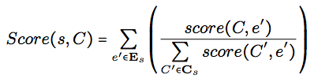
DPs-based Cleaning on Sentence Level
For Accidental DPs: All their sub-extractions and themselves are errors. Thus, the sentence parsing triggered by Accidental DPs should be dropped directly.
Intentional DPs: We check each sentence parsing triggered by an Intentional DP: correct or incorrect.
  We score the score of each possible extraction way.
  If the concerned one is not the highest score among all possible parsing ways to the sentence, we roll back the prasing.
  Scoring Function:
Notes:
Sentence s∶= {Cs,Es} where Cs is the candidate set of concepts in the sentence, and Es is the candidate set of instances in the sentences. Apparently, Ce ∈ Cs and e ∈ Es. The score that C ∈ Cs is the correct concept of the extraction as:
where score(C, e′) is the random walk score of an isA pair (C, e′).
If Score(s, Ce) is not the highest score among all Score(s, C), where C ∈ Cs, we say the extraction of s triggered by (Ce,e) is a drifting error, and it will be rolled back.

Slide 22
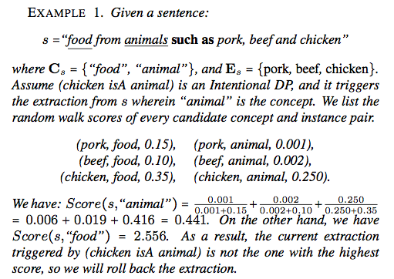
DPs-based Cleaning
Notes:
需要仔细修改！

Slide 23
Outline
The Semantic Drift Problem in Information Extraction
Previous Methods for Overcoming Semantic Drift
Our Method
  Intuition
  What is DPs (Drifting Points)?
  How to find DPs?
  How to do DPs-based Cleaning?
Experimental Results
Conclusion

Slide 24
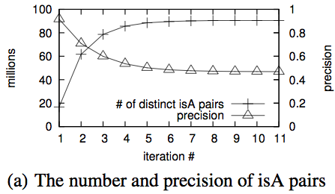
Data Set
We use the ProBase data released by the ProBase Microsoft.
  There are 326,110,911 sentences extracted from 1,679,189,480 web pages.
  The method ran for about 100 iterations to extract about 143 millions isA pairs (90.5 millions distinct ones) under 13.5 million distinct concepts, where 99.999% were obtained in the first 10 iterations.
Notes:
As presented in Figure 5(a), the number of learned distinct pairs increases dramatically from only about 16.8 millions in iteration 1 to more than 90.5 millions after all iterations. However, the pre- cision of the learned isA pairs, as was observed from more than 10k sampled data, also drops dramatically from more than 90% in iteration 1 to lower than 50% after 5 iterations.

Slide 25
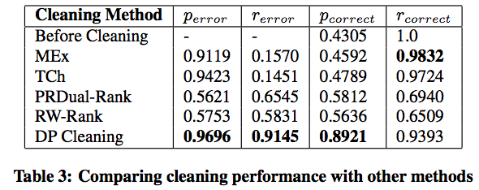
Comparison With Previous Methods
MEx Cleaning: the mutual exclusive cleaning
TCh: Type Checking
RW-Rank: Random Walk based Ranking Model

Slide 26
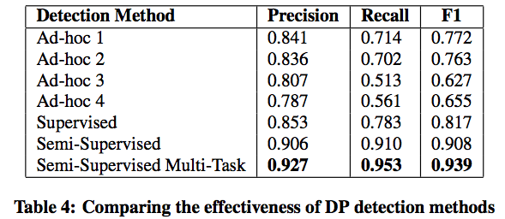
Comparison With Previous Methods

Slide 27
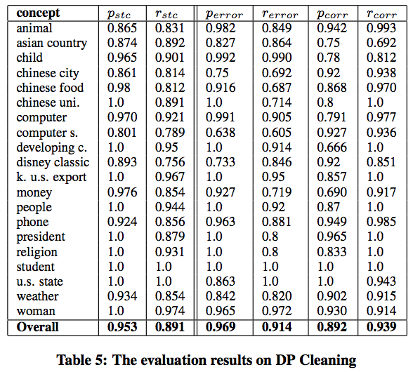
Evaluation 2: cleaning Performance

Slide 28
Efficiency Issue
Efficiency Issue should be considered, since:
1. There are millions of concepts in ProBase
2. For each concept, there are maximum 100 iterations
MapReduce:
Cosmos: A cluster of servers are used in cleaning.
Finished running the Random-walk algorithm on Cosmos (7 hours).
Finished running the DPE finding and cleaning on Cosmos (5 hours).
Finished running the Sentence Scoring on Cosmos (2.5 hours).

Slide 29
Conclusion
In this paper, we propose a novel method to overcome semantic drift by identifying drifting points (DPs) and then rolling back extractions activated by the DPs.
We show that we can effectively identify more than 90% of DPs. As a result, we can clean a large percent of semantic drift errors in iterative isA extraction. Our DP cleaning strategy enables us to achieve 90% precision and 94% recall.
As a future work, we will develop our method to work with syntax-based (i.e. pattern-based) extraction mechanism.

Slide 30



Thanks a lot for your attention!!
Really Sorry for not being able to present and answer your questions.
Please write emails to me: zhixu.li@kaust.edu.sa for any discussions or questions.

